Slide 1







UBER – TAXI COMPANY FARE PREDICTION OF UBER
Druvana Sree Sreepada
Notes:
Hello Professor,
My Name is Devendra Bupathi Rapolu. I am here today to continue our project Uber Fare Prediction that was worked by our team comprising myself, Sai Teja Munja, Richita Dayara and Druvana Sree Sreepada.

Slide 2

APPLYING MODELS
There are different models that can be applied for the Dataset considering that dependent variable is a continuous variable, so we use regression models.
Different types of Regression models can be used to perform this fare_amount.
Multiple Linear Regression, Random Forest Regression, Decision Tree Regression, Gradient Boosting Regression are some of the models that I have used in my model to perform prediction of fare_amount in the Uber Dataset.
Notes:
From the checkpoint-2, We have done all the necessary Data Pre-Processing Steps that are required and we have also gone through some visualizations to understand the issues in the Dataset where our dataset has some outliers those are removed and once the data is cleaned. Data is splitted into train and test data and then independent variables are standardized to make all values in one scale. As we know that fare amount variable is target variable and is a continuous variable. So it is necessary to use a regression model as we predict the target variable. As we know there are different regression models available and hence we are using more than one dependent variable we use multiple linear regression model instead of simple linear regression model. There are many regression models that are available like Multiple linear Regression Model, Lasso Regression Model, Polynomial Regression Model, Elastic Net Regression Model, Ridge Regression Model, Random Forest Regression Model, Decision Tree Regression Model, Gradient Boosting Regression Model. We are considering four different models in order to train the data and then evaluate the results.

Slide 3
ASSUMPTIONS OF MULTIPLE LINEAR REGRESSION
Linearity: The relationship between the dependent variable and explanatory variables is assumed to be linear.
Independence: The observations in the dataset are assumed to be independent of each other.
Homoscedasticity: The variability of the error term is assumed to be constant across all levels of the explanatory variables.
Notes:
When using multiple linear regression, we need to make certain assumptions. Firstly, we assume a linear relationship between the independent variables and the dependent variable. Additionally, we assume that each observation in the dataset is independent of the others, meaning that no row's data is an outcome of a previous row. It is also important to keep the error term constant across the independent variables.

Slide 4
APPLYING MULTIPLE LINEAR REGRESSION
Linear regression is a statistical model used for predicting a continuous variable, making it suitable for fare prediction in Uber trips.
The linear regression model assumes a linear relationship between the dependent variable (fare_amount) and the explanatory variables and by using those variables new features are created for better understanding of data for the model by using features such as distance, month of the trip , year of the trip , day of the trip , weekend or weekday , passenger count, type of car.
The model estimates the relationship between these variables by fitting a linear equation that best represents the data.
The equation takes the form: fare_amount = β₀ + β₁x₁ + β₂x₂ + ... + βₚxₚ + ɛ.
Notes:
Linear regression is a statistical model used for predicting continuous variables, making it suitable for our task. We derived various features from the latitude, longitude of pickup and drop-off locations, and the pickup date and time. By utilizing the Haversine formula, we calculated the distance. Furthermore, by converting the pickup date and time into a suitable format, we obtained the year, month, day, and day of the week. Using these features along with the passenger count, we trained the model.
The formula for the best-fit line in linear regression is y = β₀ + β₁x₁ + β₂x₂ + ... + βₚxₚ + ɛ.

Slide 5
APPLYING MULTIPLE LINEAR REGRESSION
β₀, β₁, β₂, ... , βₚ are the coefficients representing the contribution of each explanatory variable.
ɛ is the error term capturing the unexplained variation in fare_amount.
fare_amount is the dependent variable to be predicted.
x₁, x₂, ... , xₚ are the values of the respective explanatory variables.
Notes:
Here, y represents the target variable fare_amount used for prediction. β₀, β₁, β₂, ..., βₚ are coefficients representing the contribution of each independent variable, while x₁, x₂, ..., xₚ are the respective independent variable values. ɛ is the error term capturing the unexplained variation in fare_amount.

Slide 6
APPLYING MULTIPLE LINEAR REGRESSION
Data i.e. already standardized and one hot encoded is used with logistic regression model by fitting it. Once the Data is fitted with model with parameters.
Now the model will understand how each feature is explaining the dependent variable as per the above formulae.
Once the Model is ready i.e. trained we have used the model to predict on testing data I.e. also standardized and one hot encoded earlier.
Notes:
In our dataset, we did not need to perform one-hot encoding as we had mapped values to remove unnecessary encoding. Once the model was trained by fitting the training data, we used it to predict the testing data. We evaluated the model's performance using metrics such as Root Mean Square Error (RMSE), Mean Square Error (MSE), R-Squared, and Adjusted R-Squared. Among these metrics, R-Squared is particularly important for understanding how well each model performed.

Slide 7
RESULTS AND MODEL EVALUATION
We have used 4 different models i.e. Multiple Linear Regression, Random Forest, Decision Tree, Gradient Boosting Regression.
Each Model has been applied with the data I.e. ready and after fitting the model to train the data then we will use that trained model to predict fare_amount in testing dataset.
After predicting the model , Model has been evalulated with the help of Evaluation Metrics like traing and testing RSquare, MSE to identify the Accuracy and error rate in the model.
Notes:
We evaluated the model's performance using metrics such as Root Mean Square Error (RMSE), Mean Square Error (MSE), R-Squared, and Adjusted R-Squared. Among these metrics, R-Squared is particularly important for understanding how well each model performed.

Slide 8
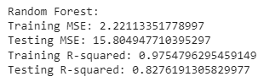
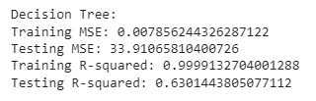
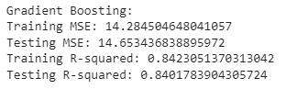
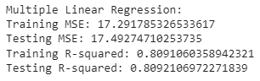
EVALUATION METRICS
Notes:
From our evaluation metrics, we observed that Gradient Boosting achieved a better R-Squared value, indicating superior performance. On the other hand, Decision Tree did not perform well based on its R-Squared value, as it suffered from overfitting during training. Random Forest and Linear Regression performed well, but there is still room for improvement by conducting better feature extraction and removing unnecessary variables to address multicollinearity.

Slide 9
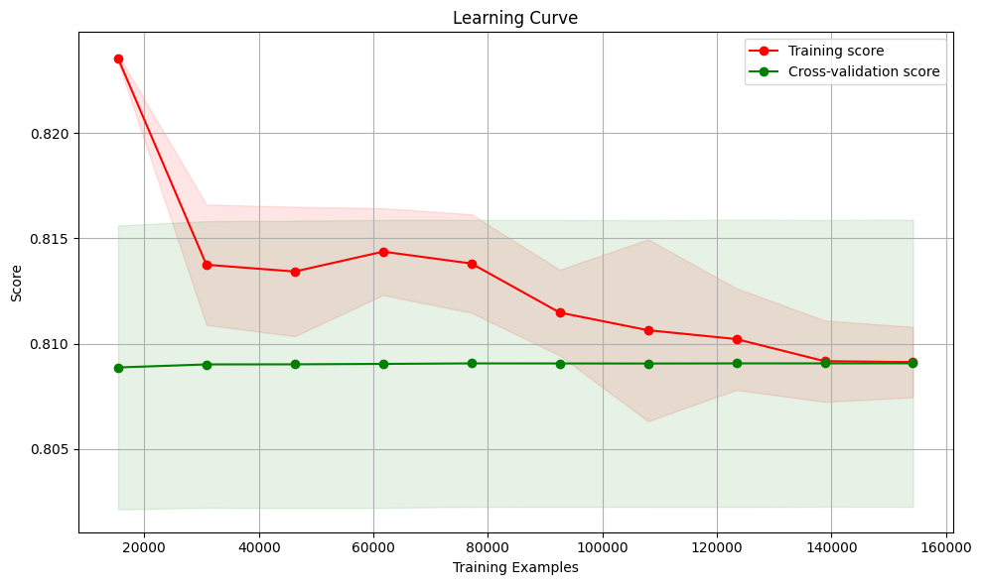
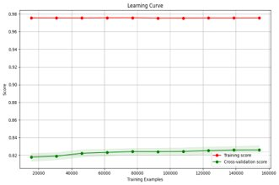
RESULTS – LEARNING CURVES
MULTIPLE LINEAR REGRESSION
MULTIPLE LINEAR REGRESSION
RANDOM FOREST
Notes:
We also plotted learning curves for each model. The curves indicated that Random Forest and Decision Trees were underfitting, as they did not show significant improvement with cross-validation.

Slide 10
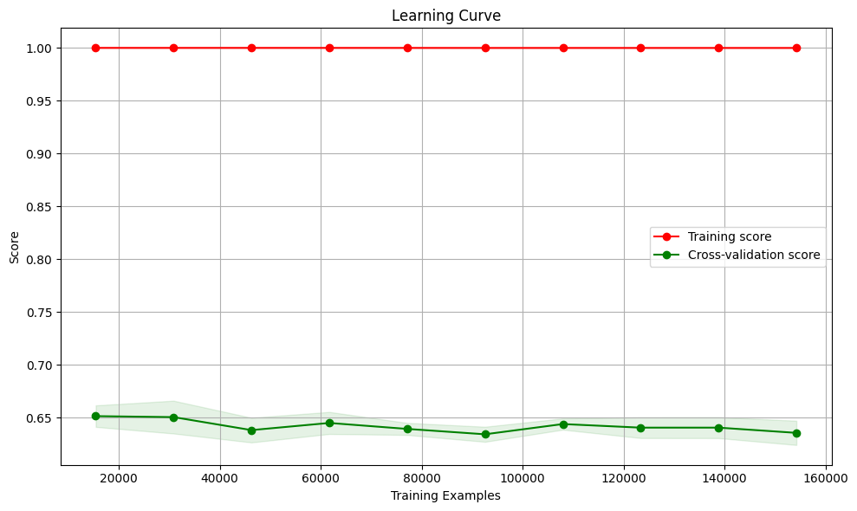
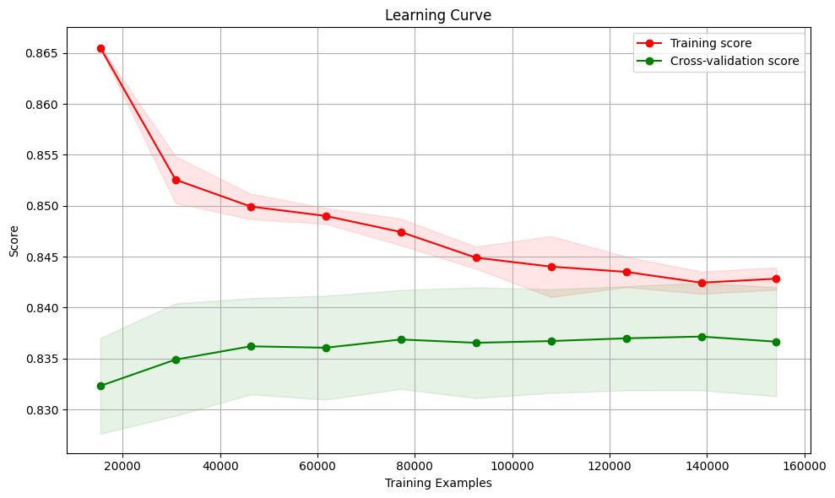
RESULTS – LEARNING CURVES
DECISION TREE
GRADIENT BOOSTING
Notes:
However, Gradient Boosting Regression demonstrated a better curve with cross-validation, indicating a better-trained model. This observation aligns with the higher R-Squared value obtained with Gradient Boosting.

Slide 11

CLOUD TOOLS TO IMPLEMENT OUR PROJECT UBER FARE PREDICTION
Azure Machine Learning Studio
IBM Watson Studio
Notes:
To Implement out project. Firstly, we obtained the dataset from Kaggle, a popular platform for sharing and discovering datasets. Once we had the dataset, we began coding in Python, leveraging its extensive libraries and frameworks for data science.
Our workflow involved various stages, such as data preprocessing, data manipulations, Feature engineering, Model Building, Evaluation and results.
Now, I would like to introduce two cloud tools that can be used to implement our Uber fare prediction project: Azure Machine Learning Studio and IBM Watson Studio.

Slide 12
AZURE MACHINE LEARNING STUDIO
High-Level Overview:
Key Features:
Drag-and-Drop Interface: Users can easily drag and drop modules to create a machine learning pipeline, including data preprocessing, feature engineering, and model training.
Pre-Built Modules: It offers a wide range of pre-built modules for common machine learning tasks, such as regression and classification.
Experimentation and Collaboration: Azure Machine Learning Studio allows users to track and compare experiments, facilitating collaboration among team members.
Automated Machine Learning: It provides an automated machine learning feature that helps users quickly identify the best model for their dataset.
Model Deployment: Once the model is trained, it can be deployed as a web service with a few clicks, enabling real-time predictions.
Benefits:
User-friendly interface with a visual workflow designer.
Integration with other Azure services like Azure Storage and Azure Functions.
Scalable infrastructure and automatic scaling based on demand.
Robust security and compliance measures.
Azure Machine Learning Studio is a visual interface offered by Microsoft Azure for building and deploying machine learning models. It provides a drag-and-drop environment that simplifies the process of creating, testing, and deploying predictive models. Azure Machine Learning Studio is a user-friendly tool suitable for implementing the Uber fare prediction project without requiring extensive coding knowledge.
Notes:
Azure Machine Learning Studio is a visual interface offered by Microsoft Azure. It simplifies the process of building and deploying machine learning models through its drag-and-drop environment. Key features include a variety of pre-built modules, collaboration capabilities, automated machine learning, and easy model deployment.

Slide 13
IBM WATSON STUDIO
High-Level Overview:
Key Features:
Data Preparation: Watson Studio provides tools for data cleaning, transformation, and feature engineering.
Model Development: It supports popular programming languages like Python and R, along with Jupyter notebooks for interactive model development.
AutoAI: Watson Studio offers an AutoAI feature that automates the process of feature selection, model training, and hyperparameter tuning.
Model Deployment: Trained models can be deployed as APIs for real-time predictions or as batch jobs for offline processing.
Benefits:
Collaborative environment for team collaboration and version control.
Integration with other IBM Watson services like Watson Machine Learning and Watson Studio AutoAI.
Scalable infrastructure with flexible deployment options.
Advanced analytics and AI capabilities with integration to IBM Watson services.
Model Monitoring: It provides monitoring capabilities to track the performance and drift of deployed models.
IBM Watson Studio is an end-to-end platform that enables data scientists to collaborate, build, and deploy machine learning models. It provides a unified environment for data preparation, model development, and deployment. Watson Studio offers a range of tools and services that can be utilized for implementing the Uber fare prediction project, allowing data scientists to leverage advanced analytics and machine learning capabilities.
Notes:
IBM Watson Studio is an end-to-end platform that enables collaboration, model development, and deployment. It provides data preparation tools, supports popular programming languages, offers an AutoAI feature for automation, and allows model deployment as APIs or batch jobs. It also includes model monitoring capabilities.

Slide 14
Thank You​
Notes:
Both tools offer user-friendly interfaces, integration with other cloud services, scalable infrastructure, and robust security measures. We can choose the tool that best fits our project requirements and preferences.

